Slide 1
Crimes in Atlanta

Slide 2
Source
http://www.atlantapd.org/i-want-to/crime-data-downloads

Slide 3
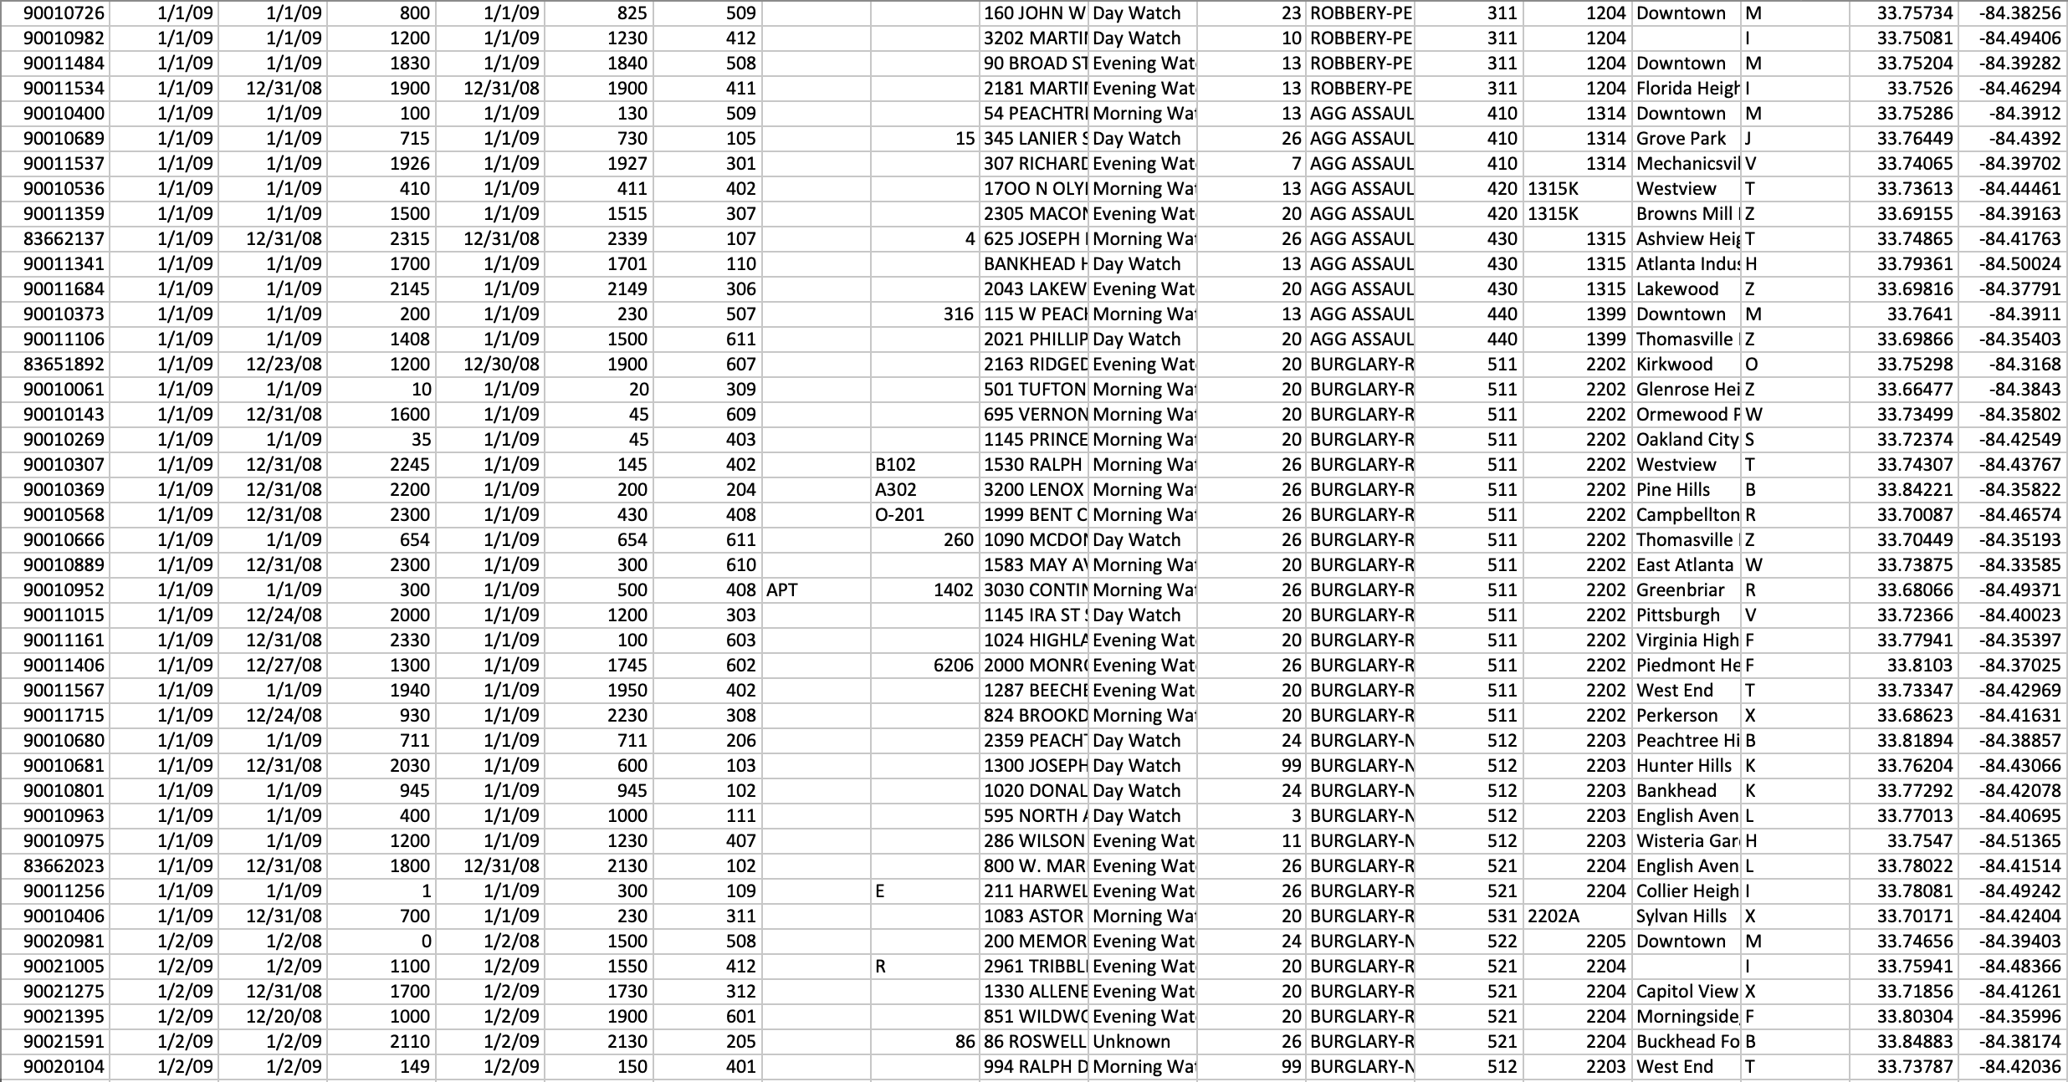
Data Filtering
Missing Data

Slide 4
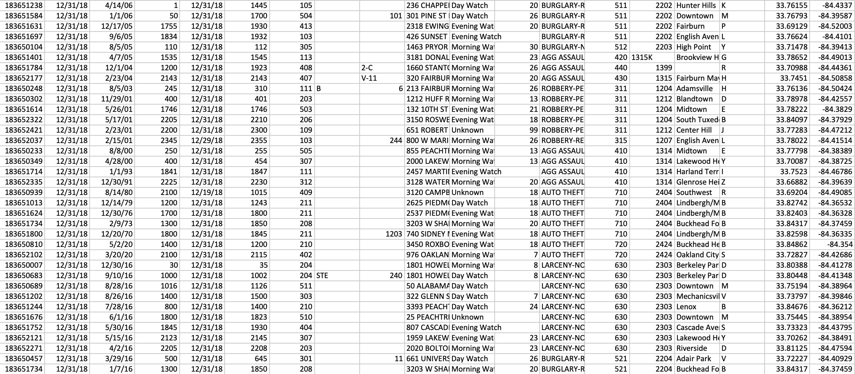
Data Filtering
Misentered
Data

Slide 5
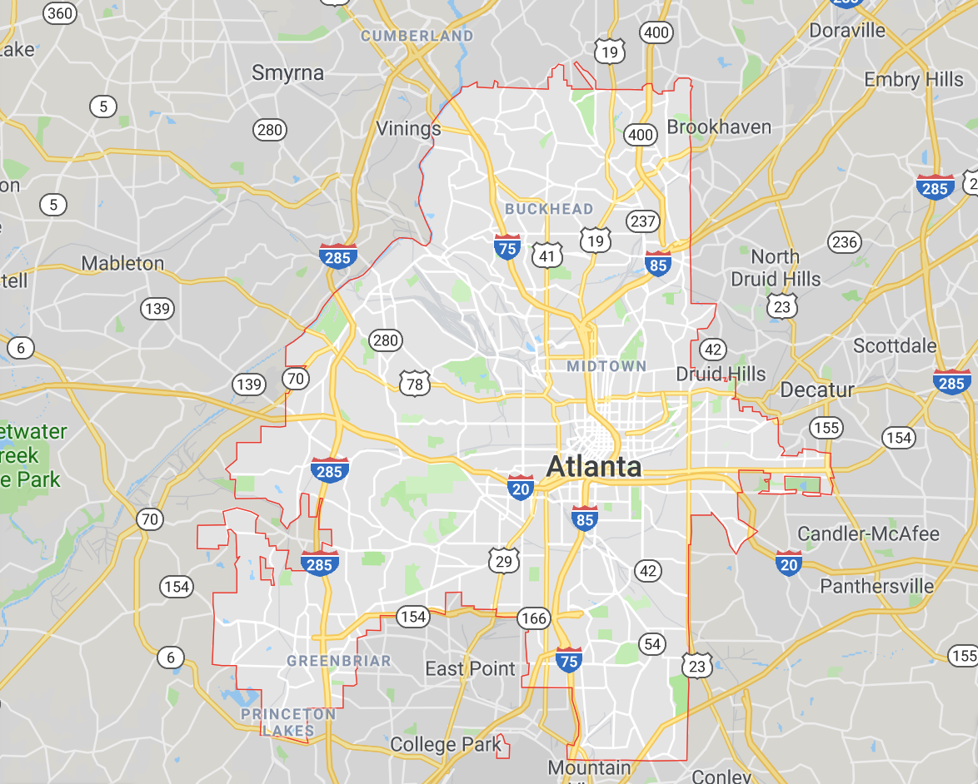
Metro-Atlanta

Slide 6
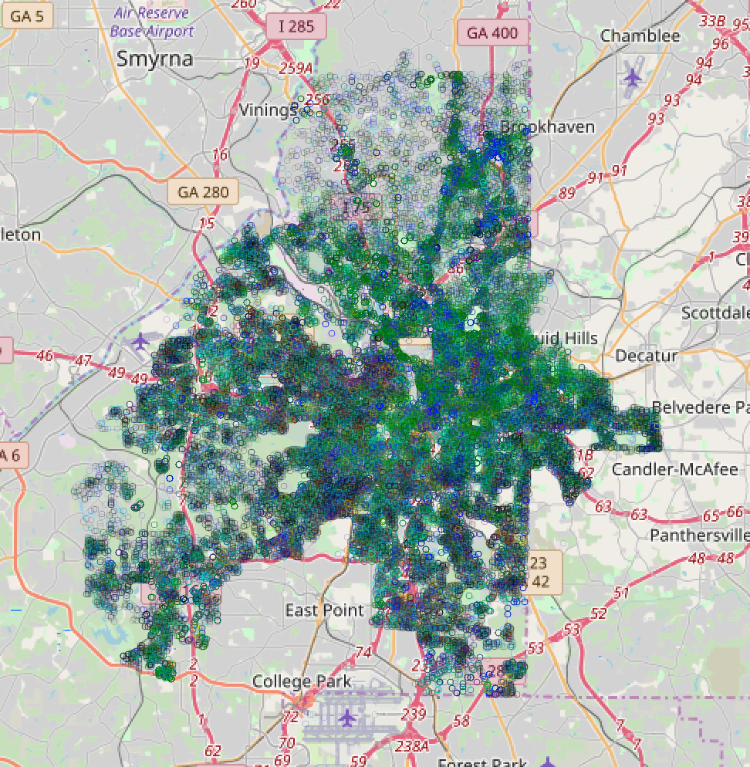
Crime Map All Crimes

Slide 7
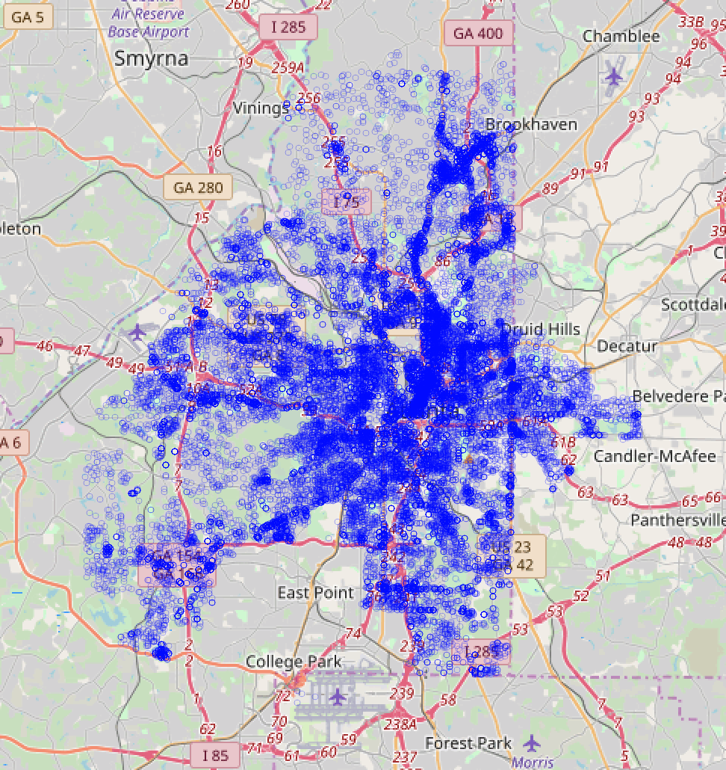
Crime Map Larceny-Non Vehicle

Slide 8
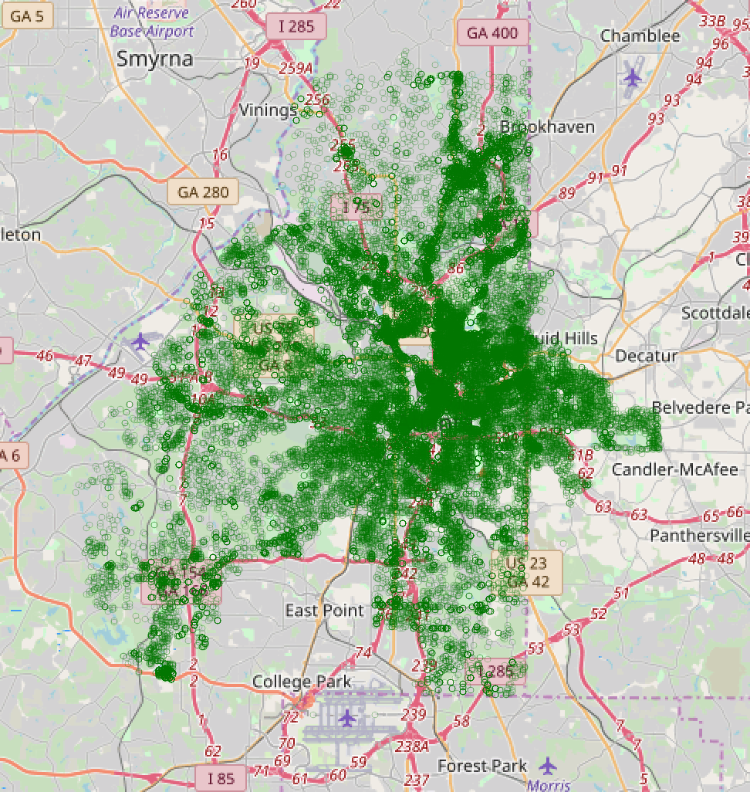
Crime Map Larceny-

Slide 9
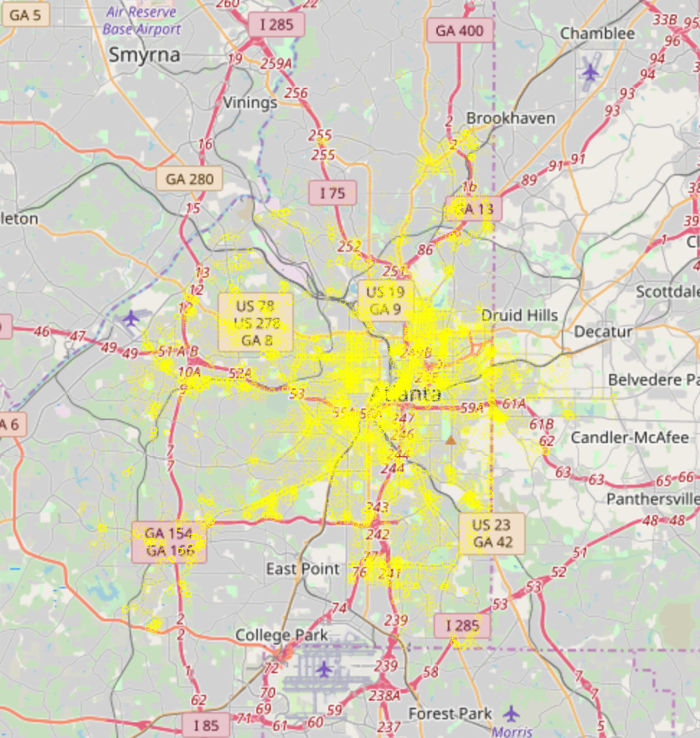
Crime Map Robbery-Pedestrian

Slide 10
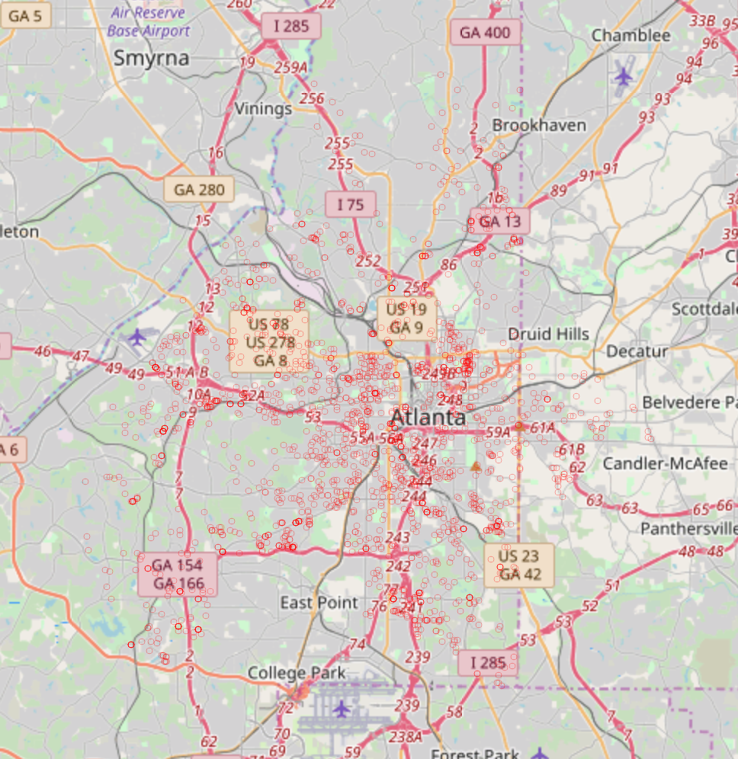
Crime Map Robbery Residence

Slide 11
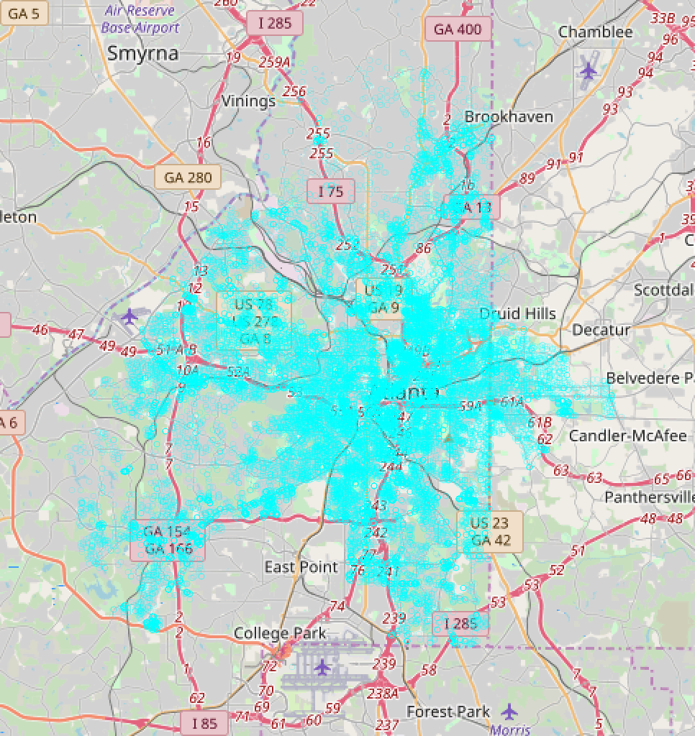
Crime Map Robbery Residence

Slide 12
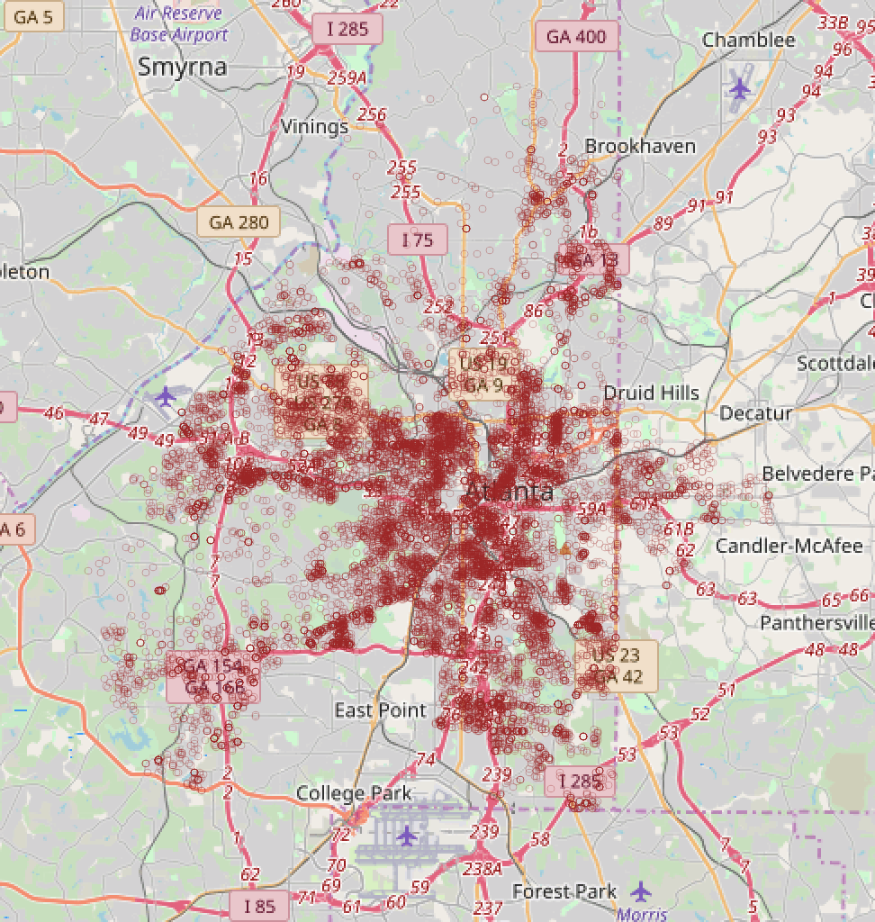
Crime Map Aggravated Assault

Slide 13
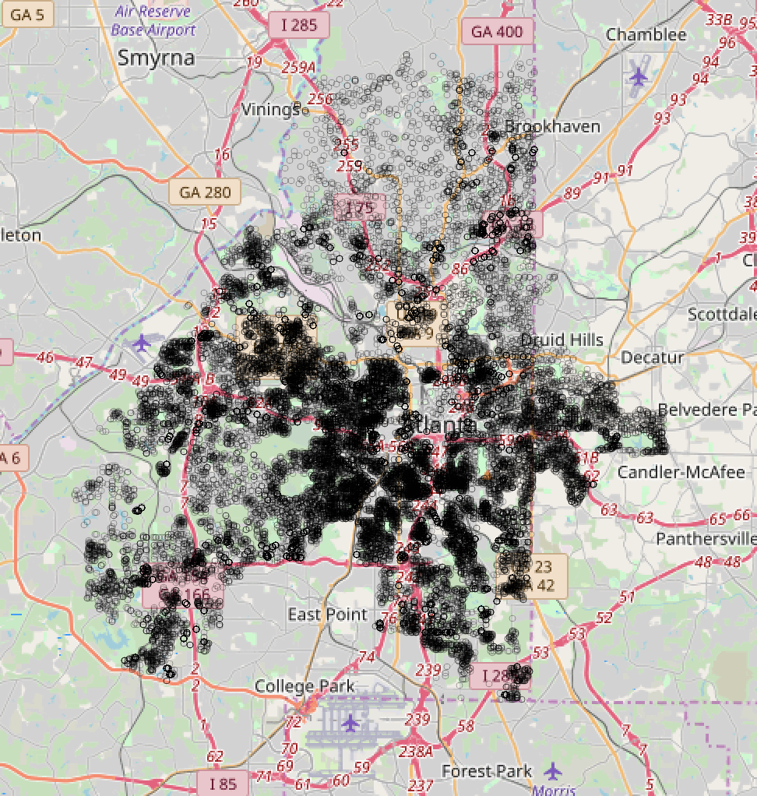
Crime Map Burglary Residence

Slide 14
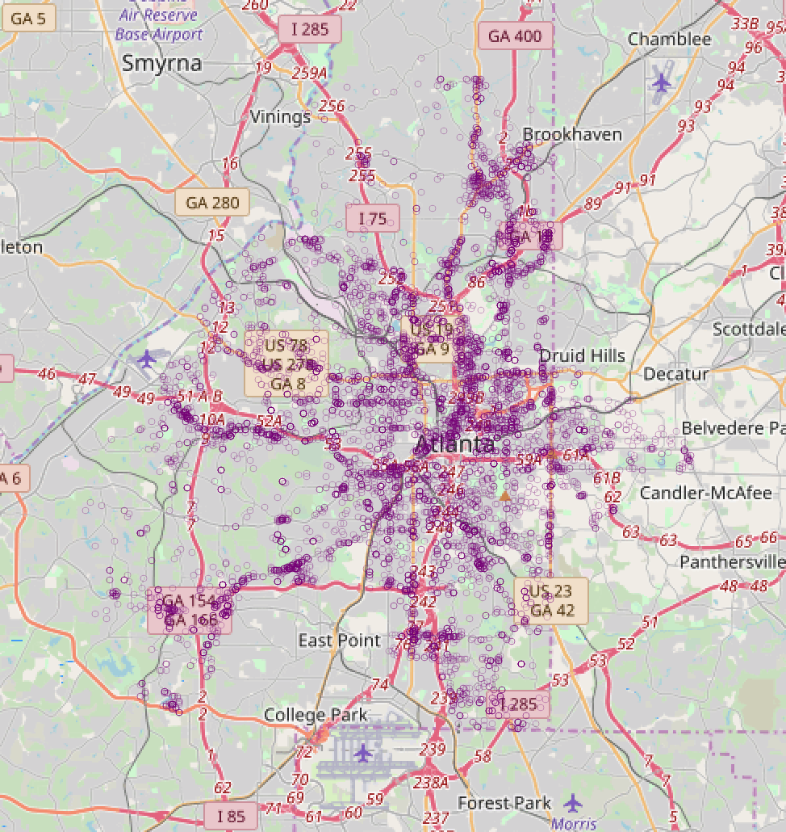
Crime Map Burglary-Non Residence

Slide 15
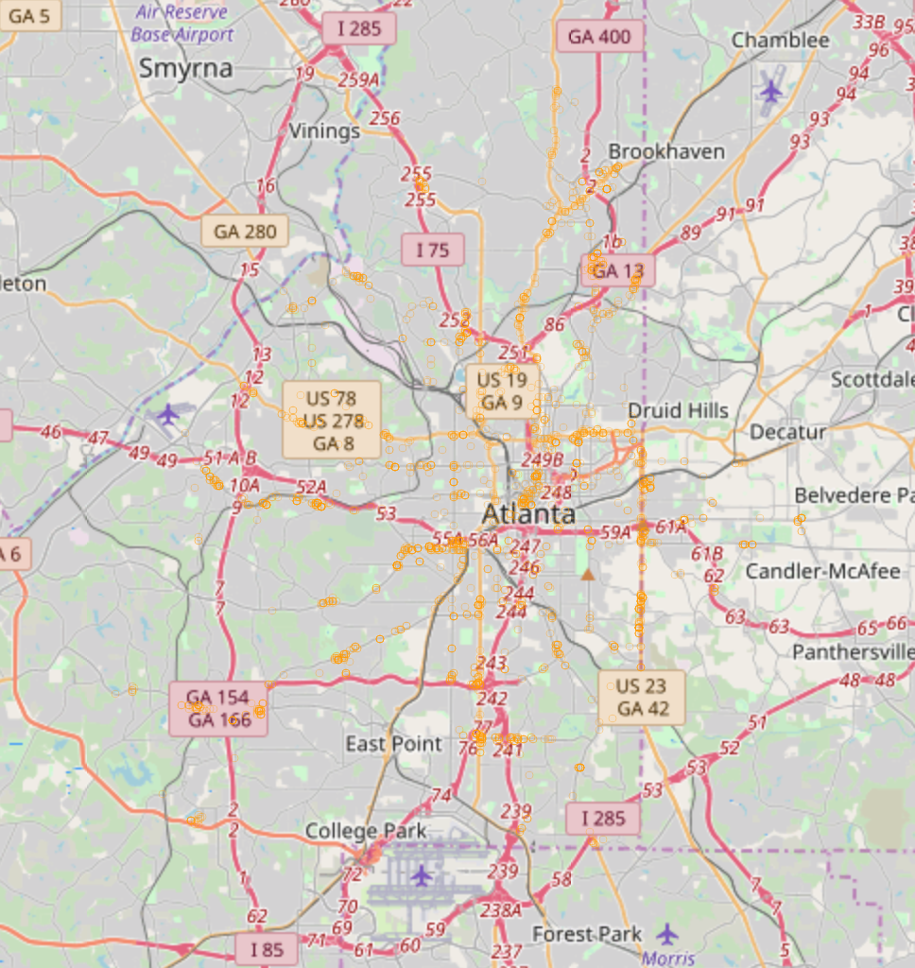
Crime Map Robbery-Commercial

Slide 16
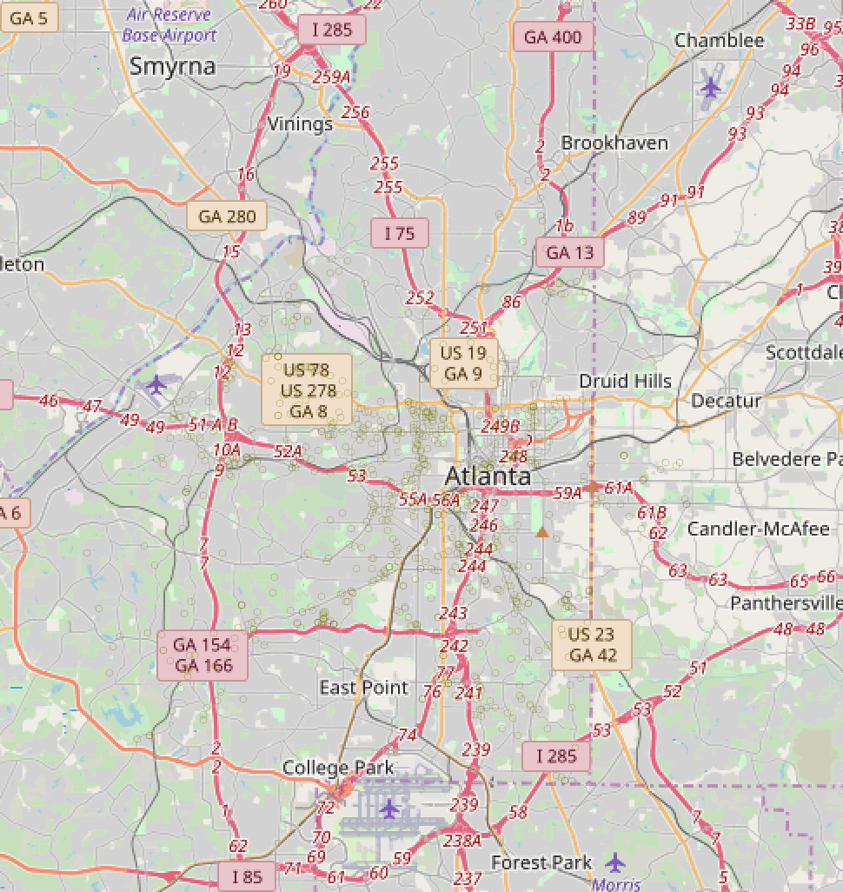
Crime Map Homicide

Slide 17
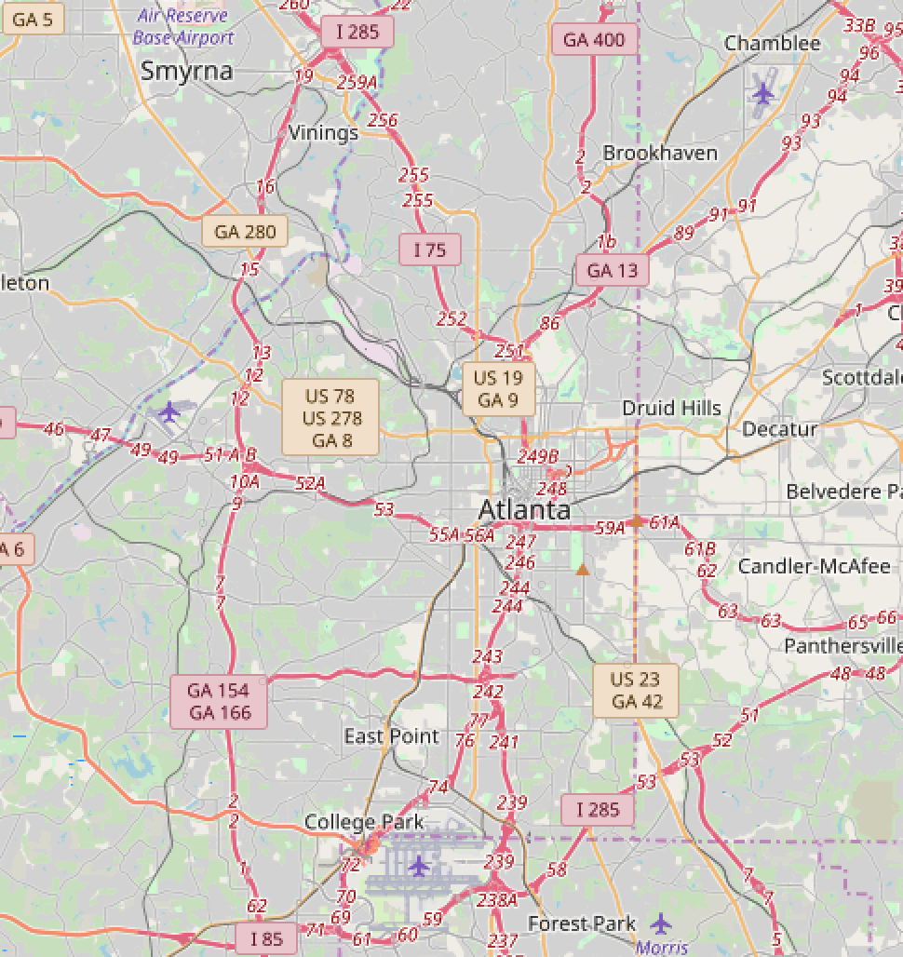
Crime Map Manslaughter

Slide 18
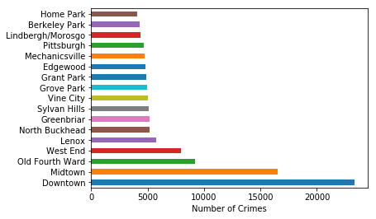
Neighborhood vs Number of Crimes

Slide 19
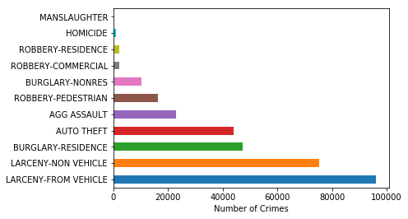
Crime Type vs Number of Crimes

Slide 20
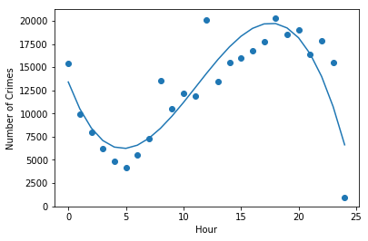
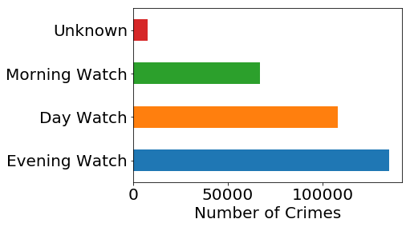
Number of Crimes vs Hour
6 PM
5 AM

Slide 21
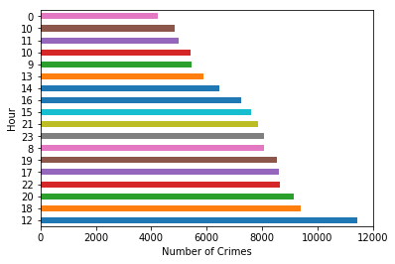
Hour vs Number of Crimes

Slide 22
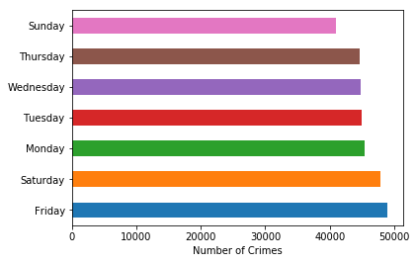
Day of Week vs Number of Crimes

Slide 23
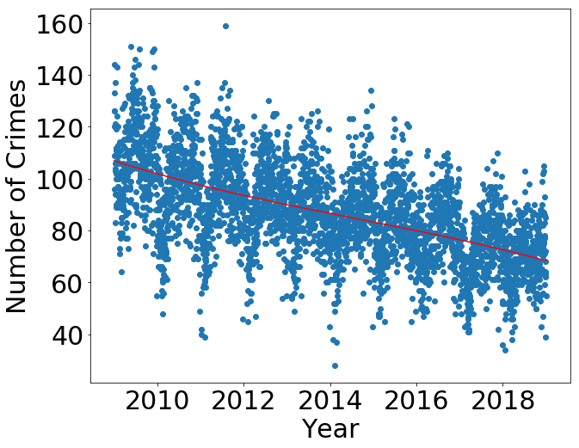
Number of Crimes vs Year
~4 crimes/year decrease

Slide 24
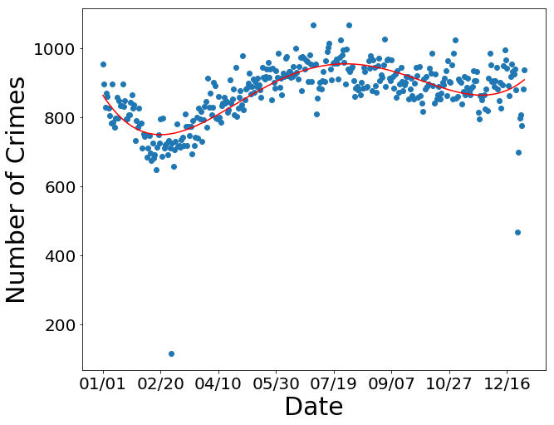
Number of Crimes vs Date
7/29
2/20

Slide 25
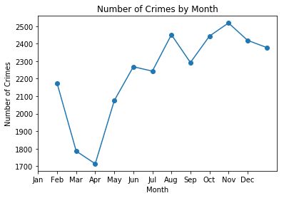
Number of Crimes vs Date

